Slide 1
Fibonacci Numbers and the Golden Ratio

Slide 2
What is the Golden Ratio?
Well, before we answer that question let's examine an interesting sequence (or list) of numbers.
Actually the series starts with 0, 1 but to make it easier we’ll just start with:
1, 1

Slide 3
To get the next number we add the previous two numbers together. So now our sequence becomes 1, 1, 2. The next number will be 3. What do you think the next number in the sequence will be? Remember, we add the previous two numbers to get the next. So the next number should be 2+3, or 5. Here is what our sequence should look like if we continue on in this fashion for a while:
1, 1, 2, 3, 5, 8, 13, 21, 34, 55, 89, 144, 233, 377, 610…

Slide 4
Now, I know what you might be thinking: "What does this have to do with the Golden Ratio? This sequence of numbers was first “discovered” by a man named Leonardo Fibonacci, and hence is known as Fibonacci's sequence.
Leonardo Fibonacci

Slide 5
The relationship of this sequence to the Golden Ratio lies not in the actual numbers of the sequence, but in the ratio of the consecutive numbers. Let's look at some of the ratios of these numbers:
1, 1, 2, 3, 5, 8, 13, 21, 34, 55, 89, 144, 233, 377, 610…

Slide 6
2/1 = 2.0 3/2 = 1.5 5/3 = 1.67 8/5 = 1.6 13/8 = 1.625 21/13 = 1.615 34/21 = 1.619 55/34 = 1.618 89/55 = 1.618
Since a Ratio is basically a fraction (or a division problem) we will find the ratios of these numbers by dividing the larger number by the smaller number that fall consecutively in the series.
So, what is the ratio of the 2nd and 3rd numbers?
Well, 2 is the 3rd number divided by the 2nd number which is 1
2 divided by 1 = 2
And the ratios continue like this….

Slide 7
Aha! Notice that as we continue down the sequence, the ratios seem to be converging upon one number (from both sides of the number)!
2/1 = 2.0 (bigger)
3/2 = 1.5 (smaller)
5/3 = 1.67(bigger)
8/5 = 1.6(smaller)
13/8 = 1.625 (bigger) 21/13 = 1.615 (smaller) 34/21 = 1.619 (bigger) 55/34 = 1.618(smaller) 89/55 = 1.618
Fibonacci Number calculator

Slide 8
5/3 = 1.67 8/5 = 1.6 13/8 = 1.625 21/13 = 1.615 34/21 = 1.619 55/34 = 1.618 89/55 = 1.618 Notice that I have rounded my ratios to the third decimal place. If we examine 55/34 and 89/55 more closely, we will see that their decimal values are actually not the same. But what do you think will happen if we continue to look at the ratios as the numbers in the sequence get larger and larger? That's right: the ratio will eventually become the same number, and that number is the Golden Ratio!

Slide 9
The Golden Ratio is what we call an irrational number: it has an infinite number of decimal places and it never repeats itself! Generally, we round the Golden Ratio to 1.618.

Slide 10
We work with another important irrational number in Geometry: pi, which is approximately 3.14. Since we don't want to make the Golden Ratio feel left out, we will give it its own Greek letter: phi.
Φ φ Phi

Slide 11
which is equal to:

Slide 12
One more interesting thing about Phi is its reciprocal. If you take the ratio of any number in the Fibonacci sequence to the next number (this is the reverse of what we did before), the ratio will approach the approximation 0.618. This is the reciprocal of Phi: 1 / 1.618 = 0.618. It is highly unusual for the decimal integers of a number and its reciprocal to be exactly the same. In fact, I cannot name another number that has this property! This only adds to the mystique of the Golden Ratio and leads us to ask: What makes it so special?

Slide 13
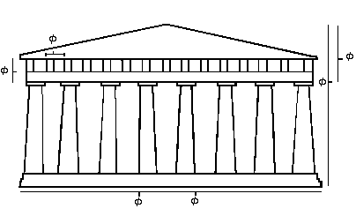
How about Architecture?

Slide 14
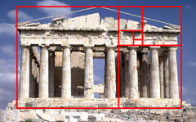
Further classic subdivisions of the rectangle align perfectly with major architectural features of the structure.
Further classic subdivisions of the rectangle align perfectly with major architectural features of the structure.

Slide 15
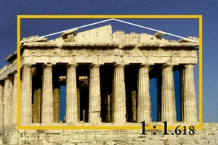

Slide 16
The Golden Ratio in Art Now let's go back and try to discover the Golden Ratio in art. We will concentrate on the works of Leonardo da Vinci, as he was not only a great artist but also a genius when it came to mathematics and invention.

Slide 17
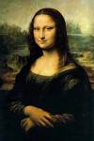

Slide 18
The Mona Lisa - Measure the length and the width of the painting itself. The ratio is, of course, Golden. Draw a rectangle around Mona's face (from the top of the forehead to the base of the chin, and from left cheek to right cheek) and notice that this, too, is a Golden rectangle.

Slide 19
Leonardo da Vinci's talent as an artist may well have been outweighed by his talents as a mathematician. He incorporated geometry into many of his paintings, with the Golden Ratio being just one of his many mathematical tools. Why do you think he used it so much? Experts agree that he probably thought that Golden measurements made his paintings more attractive. Maybe he was just a little too obsessed with perfection. However, he was not the only one to use Golden properties in his work.

Slide 20
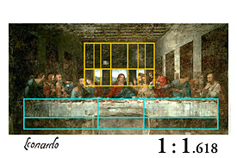

Slide 21
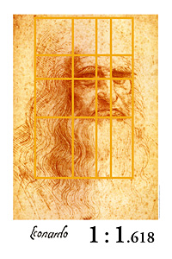

Slide 22
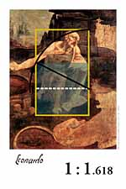

Slide 23
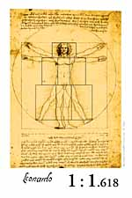

Slide 24
Constructing A Golden Rectangle Isn't it strange that the Golden Ratio came up in such unexpected places? Well let's see if we can find out why. The Greeks were the first to call phi the Golden Ratio. They associated the number with perfection. It seems to be part of human nature or instinct for us to find things that contain the Golden Ratio naturally attractive - such as the "perfect" rectangle. Realizing this, designers have tried to incorporate the Golden Ratio into their designs so as to make them more pleasing to the eye. Doors, notebook paper, textbooks, etc. all seem more attractive if their sides have a ratio close to phi. Now, let's see if we can construct our own "perfect" rectangle.

Slide 25
Method One 1. We'll start by making a square, any square (just remember that all sides have to have the same length, and all angles have to measure 90 degrees!): 2.Now, let's divide the square in half (bisect it). Be sure to use your protractor to divide the base and to form another 90 degree angle:

Slide 26
Measure the length of the diagonal and make a note of it.
Now, draw in one of the diagonals of one of the rectangles

Slide 27
Now extend the base of the square from the midpoint of the base by a distance equal to the length of the diagonal

Slide 28
Construct a new line perpendicular to the base at the end of our new line, and then connect to form a rectangle: Measure the length and the width of your rectangle.
Now, find the ratio of the length to the width.
Are you surprised by the result? The rectangle you have made is called a Golden Rectangle because it is "perfectly" proportional.

Slide 29
Constructing a Golden Rectangle - Method Two Now, let's try a different method that will relate the rectangle to the Fibonacci series we looked at. We'll start with a square. The size does not matter, as long as all sides are congruent. We'll use a small square to conserve space, because we are going to build our golden rectangle around this square. Please note that the golden area is what your rectangle will eventually look like.

Slide 30
Now, let's build another, congruent square right next to the first one: Now we have a rectangle with a width 1 and length 2 units. Let's build a square on top of this rectangle, so that the new square will have a side of 2 units: Notice that we have a new rectangle with width 2 and length 3.

Slide 31
Let's continue the process, building another square on the right of our rectangle. This square will have a side of 3: Now we have a rectangle of width 3 and length 5.

Slide 32
Again, let's build upon this rectangle and construct a square underneath, with a side of 5:

Slide 33
The new rectangle has a width of 5 and a length of 8. Let's continue to the left with a square with side 8:

Slide 34
Have you noticed the pattern yet? The new rectangle has a width of 8 and a length of 13. Let's continue with one final square on top, with a side of 13:

Slide 35
Our final rectangle has a width of 13 and a length of 21. Notice that we have constructed our golden rectangle using square that had successive side lengths from the Fibonacci sequence (1, 1, 2, 3, 5, 8, 13, ...)! No wonder our rectangle is golden! Each successive rectangle that we constructed had a width and length that were consecutive terms in the Fibonacci sequence. So if we divide the length by the width, we will arrive at the Golden Ratio! Of course, our rectangle is not "perfectly" golden. We could keep the process going until the sides approximated the ratio better, but for our purposes a length of 21 and a width of 13 are sufficient.

Slide 36
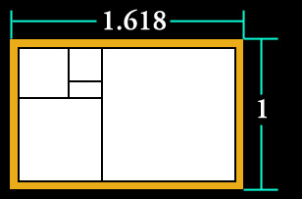
34
21
Do the Math!! 34 divided by 21 =1.61904761904
Remember that the farther into the sequence we
go the closer the ratio gets to being perfect!

Slide 37
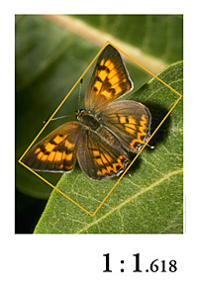

Slide 38
Constructing a Golden Spiral Notice how we built our rectangle in a counterclockwise direction. This leads us into another interesting characteristic of the Golden Ratio. Let's look at the rectangle with all of our construction lines drawn in:

Slide 40
We are going to concentrate on the squares that we drew, starting with the two smallest ones. Let's start with the one on the right. Connect the upper right corner to the lower left corner with an arc that is one fourth of a circle

Slide 41
We are going to concentrate on the squares that we drew, starting with the two smallest ones. Let's start with the one on the right. Connect the upper right corner to the lower left corner with an arc that is one fourth of a circle: Then continue your line into the second square on the left, again with an arc that is one fourth of a circle: We will continue this process until each square has an arc inside of it, with all of them connected as a continuous line. The line should look like a spiral when we are done. Here is an example of what your spiral should look like:

Slide 42
Golden Spiral manipulative

Slide 43
Now what was the point of that? The point is that this "golden spiral" occurs frequently in nature. If you look closely enough, you might find a golden spiral in the head of a daisy, in a pinecone, in sunflowers, or in a nautilus shell that you might find on a beach or even in your ear! Here are some examples:

Slide 44
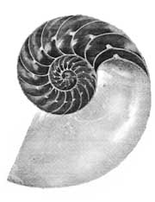
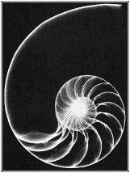
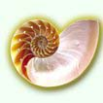

Slide 45
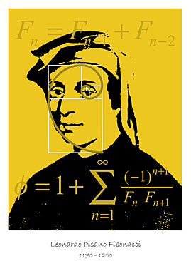

Slide 46
So, why do shapes that exhibit the Golden Ratio seem more appealing to the human eye? No one really knows for sure. But we do have evidence that the Golden Ratio seems to be Nature's perfect number.

Slide 47
Somebody with a lot of time on their hands discovered that the individual florets of the daisy (and of a sunflower as well) grow in two spirals extending out from the center. The first spiral has 21 arms, while the other has 34. Do these numbers sound familiar?

Slide 49
They should - they are Fibonacci numbers! And their ratio, of course, is the Golden Ratio.

Slide 50
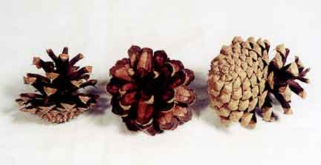
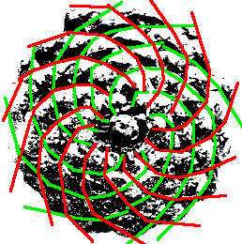
We can say the same thing about the spirals of a pinecone, where spirals from the center have 5 and 8 arms, respectively (or of 8 and 13, depending on the size)- again, two Fibonacci numbers:

Slide 51
A pineapple has three arms of 5, 8, and 13 - even more evidence that this is not a coincidence. Now is Nature playing some kind of cruel game with us? No one knows for sure, but scientists speculate that plants that grow in spiral formation do so in Fibonacci numbers because this arrangement makes for the perfect spacing for growth. So for some reason, these numbers provide the perfect arrangement for maximum growth potential and survival of the plant.

Slide 52
a/g = cm b/d = cm i/j = cm i/c = cm e/l = cm f/h = cm k/e = cm
Now find the following ratios:
face applet

Slide 53
a = Top-of-head to chin = cm b = Top-of-head to pupil = cm c = Pupil to nosetip = cm d = Pupil to lip = cm e = Width of nose = cm f = Outside distance between eyes = cm g = Width of head = cm h = Hairline to pupil = cm i = Nosetip to chin = cm j = Lips to chin = cm k = Length of lips = cm l = Nosetip to lips = cm

Slide 54
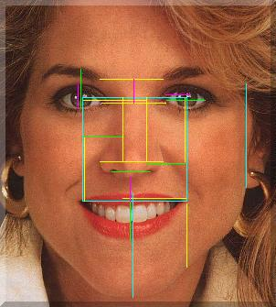
The blue line defines a perfect square of the pupils and outside corners of the mouth. The golden section of these four blue lines defines the nose, the tip of the nose, the inside of the nostrils, the two rises of the upper lip and the inner points of the ear. The blue line also defines the distance from the upper lip to the bottom of the chin.
The yellow line, a golden section of the blue line, defines the width of the nose, the distance between the eyes and eye brows and the distance from the pupils to the tip of the nose.
The green line, a golden section of the yellow line defines the width of the eye, the distance at the pupil from the eye lash to the eye brow and the distance between the nostrils.
The magenta line, a golden section of the green line, defines the distance from the upper lip to the bottom of the nose and several dimensions

Slide 55
The ratio of your forearm to hand is Phi

